Slide 1
Matrix Approach for ISBA-CTRIP
Muhammad Mohsin Abrar

Slide 2
ISBA-CTRIP
Model Name: (Interaction Soil-Biosphere-Atmosphere)-CTRIP
Lead PI or contact person and her/his affiliation: Christine Delire, CNRM, Centre National de Recherches Météorologiques, Université de Toulouse, 31057, France (Email: christine.delire@meteo.fr)
Static or dynamic vegetation: Static
Number of plant functional types: 16 plant functional types (9 tree and 1 shrub types, 3 grass types and 3 crop types)
What disturbances are simulated (e.g., land use or fire etc.)?: Fire, Landuse change
Number of pools: Total = 24 [16 vegetation types (9 tree and 1 shrub types, 3 grass types and 3 crop types) alongside desert, rocks and permanent snow, The 4 litter and 3 soil carbon pools, and dissolved organic carbon]

Slide 3



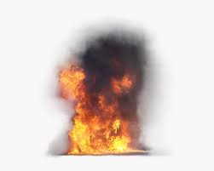



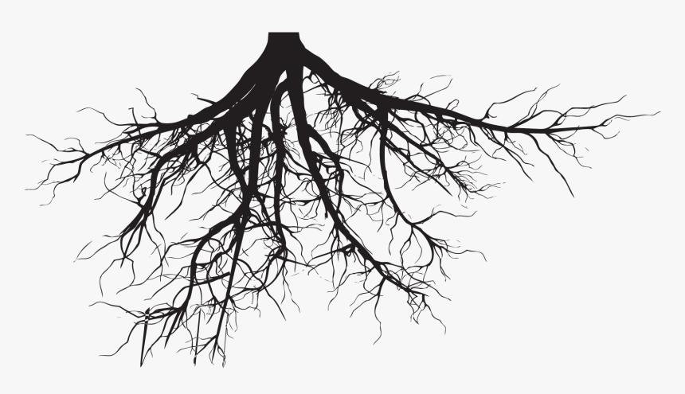
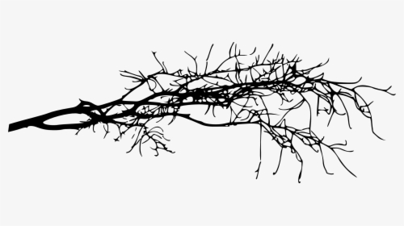
Carbon Flow Diagram
Photosynthesis
ISBA-CTRIP
based on
CO₂
GPP
NPP
Plant respiration
Mesophyll conductance (Calvet et al. 1998)
Leaf
Stem/twigs
Wood
Turnover
CO₂
CO₂
CO₂
CO₂
Soil heterorespiration
Fire
CO₂
CO₂
Litter pools
Metabolic
Structural
Aboveground
Belowground
CO₂
?
CO₂
CO₂
Active carbon
Slow carbon
Passive carbon
C pools
CO₂
CO₂
C leaching
DOC

Slide 4
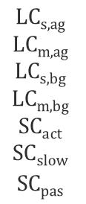
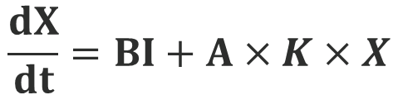


Matrix equation
$$\frac{dX}{dt}=BI+A×K×X$$
dX₁/dt
$$\begin{aligned}β1 \\ β2 \\ β3 \\ β4 \\ \text{0} \\ \text{0} \\ \text{0} \end{aligned}$$
-1 0 0 0 0 0 0
0 -1 0 0 0 0 0
0 0 -1 0 0 0 0
0 0 0 -1 0 0 0
f51 f52 f53 f54 -1 0 0
0 0 f63 f64 f65 -1 0
0 0 0 0 f75 f76 -1
dX₂/dt
dX₃/dt
=
I +
dX₄/dt
dX₅/dt
dX₆/dt
dX₇/dt
k₁ 0 0 0 0 0 0
0 k₂ 0 0 0 0 0
0 0 k₃ 0 0 0 0
0 0 0 k₄ 0 0 0
0 0 0 0 k₅ 0 0
0 0 0 0 0 k₆ 0
0 0 0 0 0 0 k₇
$$\begin{aligned}\text{LC}\text{s}\text{,}\text{ag} \\ \text{LC}\text{m}\text{,}\text{ag} \\ \text{LC}\text{s}\text{,}\text{bg} \\ \text{LC}\text{m}\text{,}\text{bg} \\ \text{SC}\text{act} \\ \text{SC}\text{slow} \\ \text{SC}\text{pas} \end{aligned}$$
$X$ =
K =

Slide 5
Carbon Flow diagram
Leaf (x₁)
Stem/twigs
(X₂)
Wood
(X₃)
f41
f52
f63
f73
f51
Metabolic litter
(x₄)
Structural litter
(x₅)
Aboveground litter
(x₆)
Belowground litter
(x₇)
Active C pool (x₈)
Slow C pool (x₉)
Passive C pool (x₁₀)
f108
f810

Slide 6
Litter and C pools
Soil layer =1
1) LC_{s,ag} Aboveground structural litter
2) LC_{m,ag} Aboveground metabolic litter
3) LC_{s,bg} Belowground structural litter
4) LC_{m,bg} Belowground metabolic litter
5) SC_{act} Active soil carbon
6) SC_{slow} Slow soil carbon
7) SC_{pas} Passive soil carbon
Block matrix = 7x7

Slide 7


